Slide 1
Analyzing HR Data
Jakob Orel

Slide 2
Intro to the Dataset
Human Resources- Employee Information
Synthetically created- Not based on a real organization
Dr. Carla Patalona: HR Expert and Dean of DBA Programs, New England College of Business
1 csv file with 311 observations and 36 columns (originally)

Slide 3
Structure of the Data
Employee_Name
EmpID
MarriedID
MaritalStatusID
GenderID
EmpStatusID
DeptID
PerfScoreID
FromDiversityJobFairID
Salary
Termd
PositionID
Position
State
Zip
DOB
Sex
MaritalDesc
CitizenDesc
HispanicLatino
RaceDesc
DateofHire
DateofTermination
TermReason
EmploymentStatus
Department
ManagerName
ManagerID
RecruitmentSource
PerformanceScore
EngagementSurvey
EmpSatisfaction
SpecialProjectsCount
LastPerformanceReview_Date
DaysLateLast30
Absences

Slide 4
Questions to Explore as an HR Manager
Is the organization diverse in sex and race?
How are we recruiting for minority groups in gender or race? How can we hire more effectively to become more diverse?
Is there bias for the salaries of employees based on gender or race?
How do we keep employees longer? What variables lead to a higher likelihood of employees quitting?

Slide 5
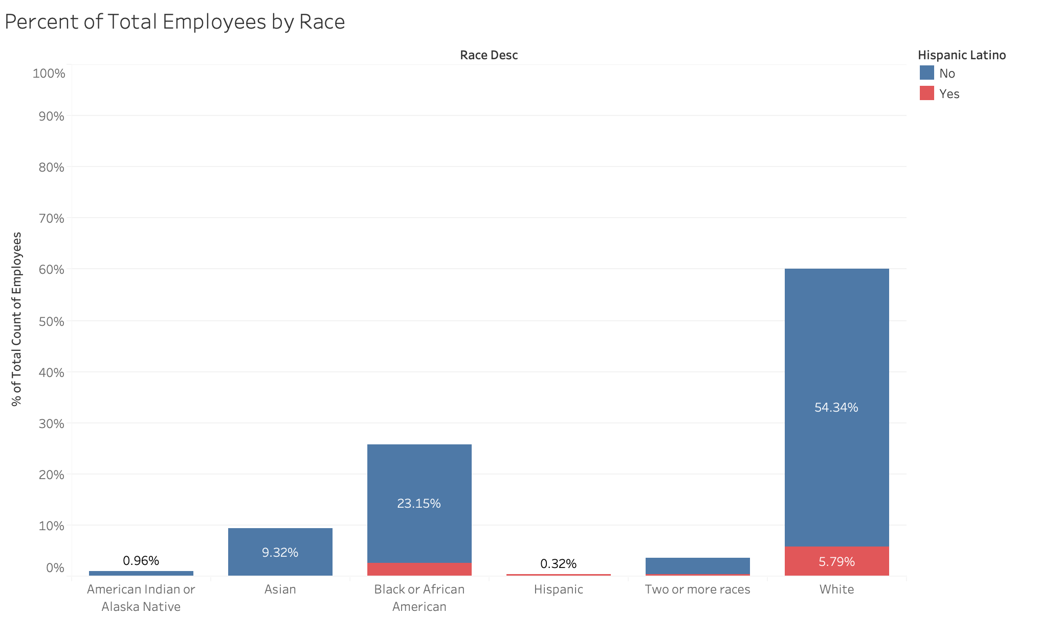
Notes:
Populations: White (76.3%), Black (13.4%), Asian (5.8%), American Native (1.3%), Two or more (2.8%), Hispanic (18.5%) US Census Bureau, 2018

Slide 6
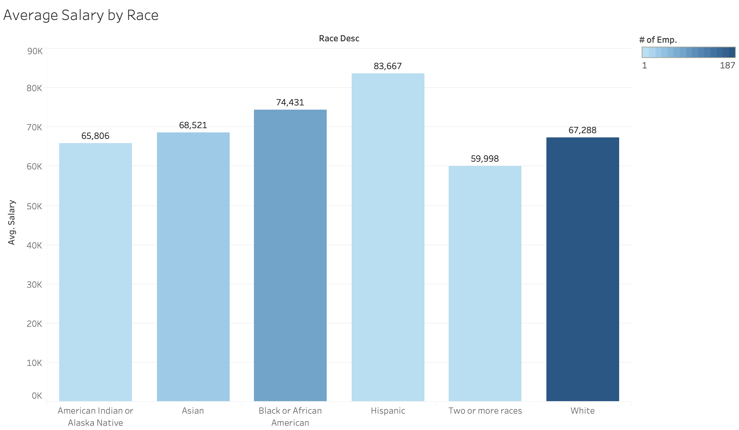

Slide 7
Statistical Analysis
Is the average salary of Black/African American employees significantly different from the average salary of White employees?
Mann-Whitney test: non-normal un-matched data
W = 8496.5, p-value = 0.07879
Not significantly different
Student’s t-test: sample estimates: mean of x (74431.02) mean of y (67287.55)
t = 1.9109, df = 130.3, p-value = 0.05821

Slide 8
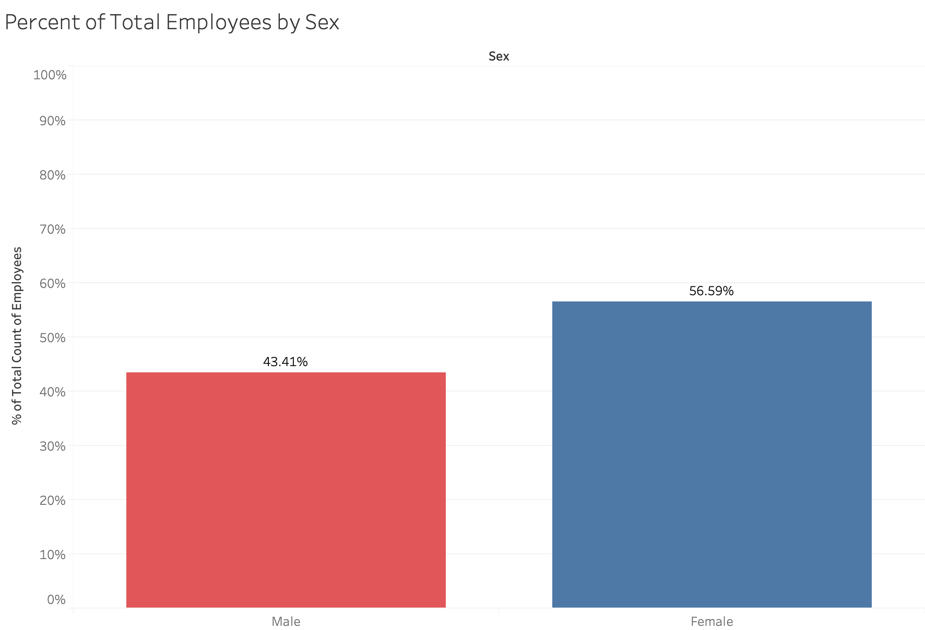

Slide 9
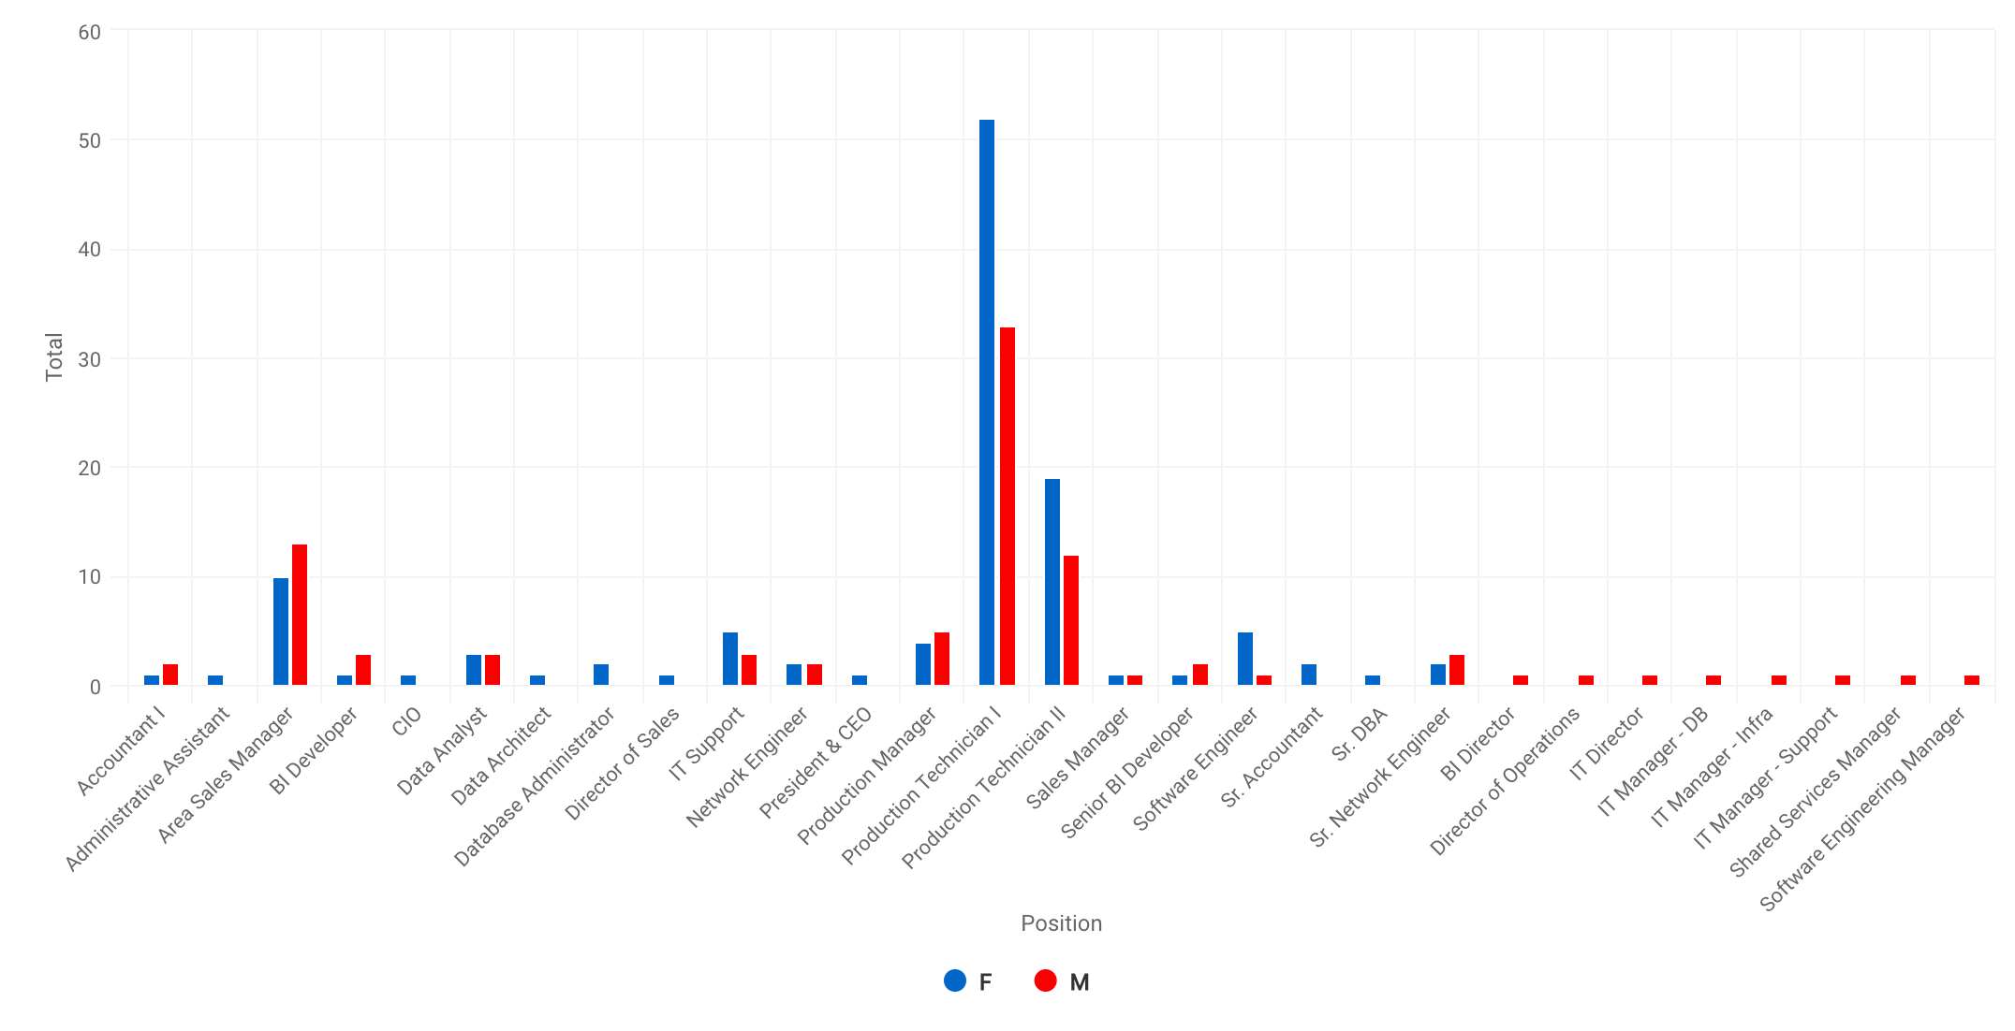

Slide 10
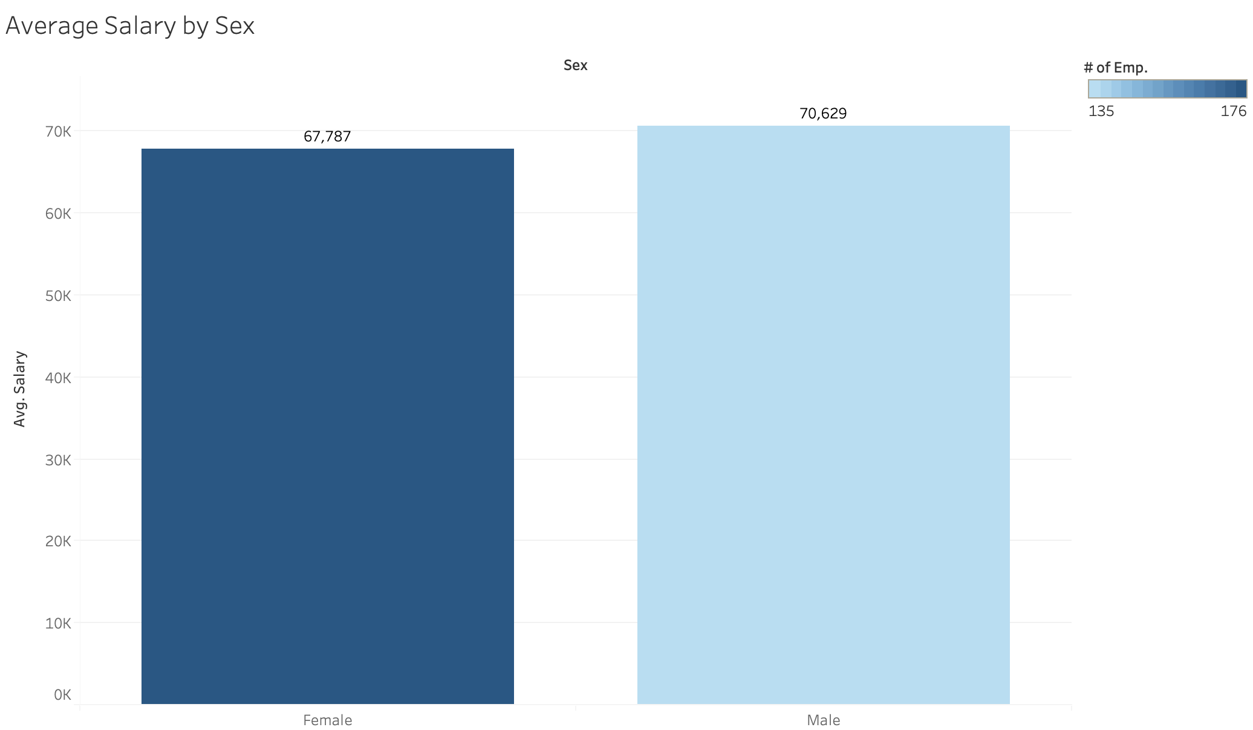
Notes:
Maybe it would be useful to break this down by position?

Slide 11
Statistical Analysis
Is the average salary for male employees statistically significantly different from the average salary for female employees?
Mann-Whitney test: non-normal un-matched data
W = 10870, p-value = 0.1988
Not significantly different
Student’s t-test: sample estimates: mean of x (67786.73) mean of y (70629.40)
t = -0.9956, df = 296.39, p-value = 0.3203

Slide 12
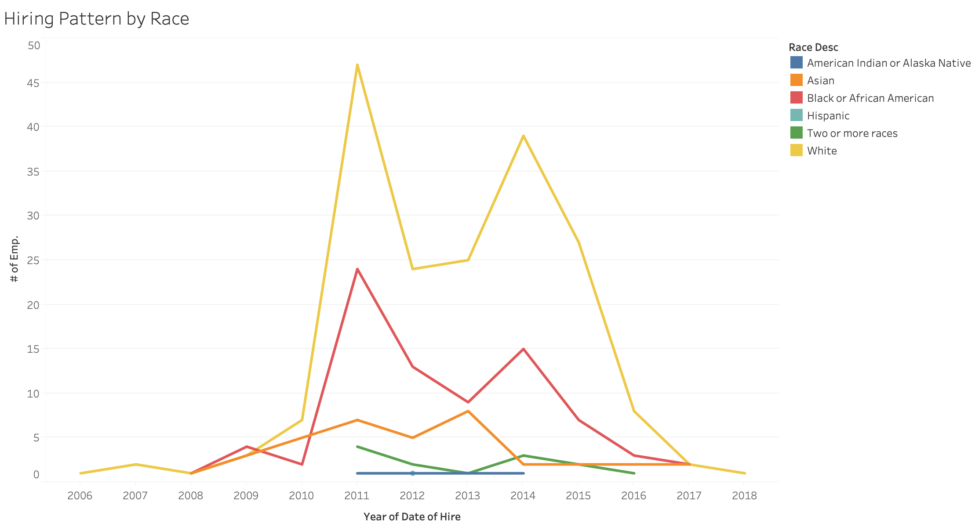

Slide 13
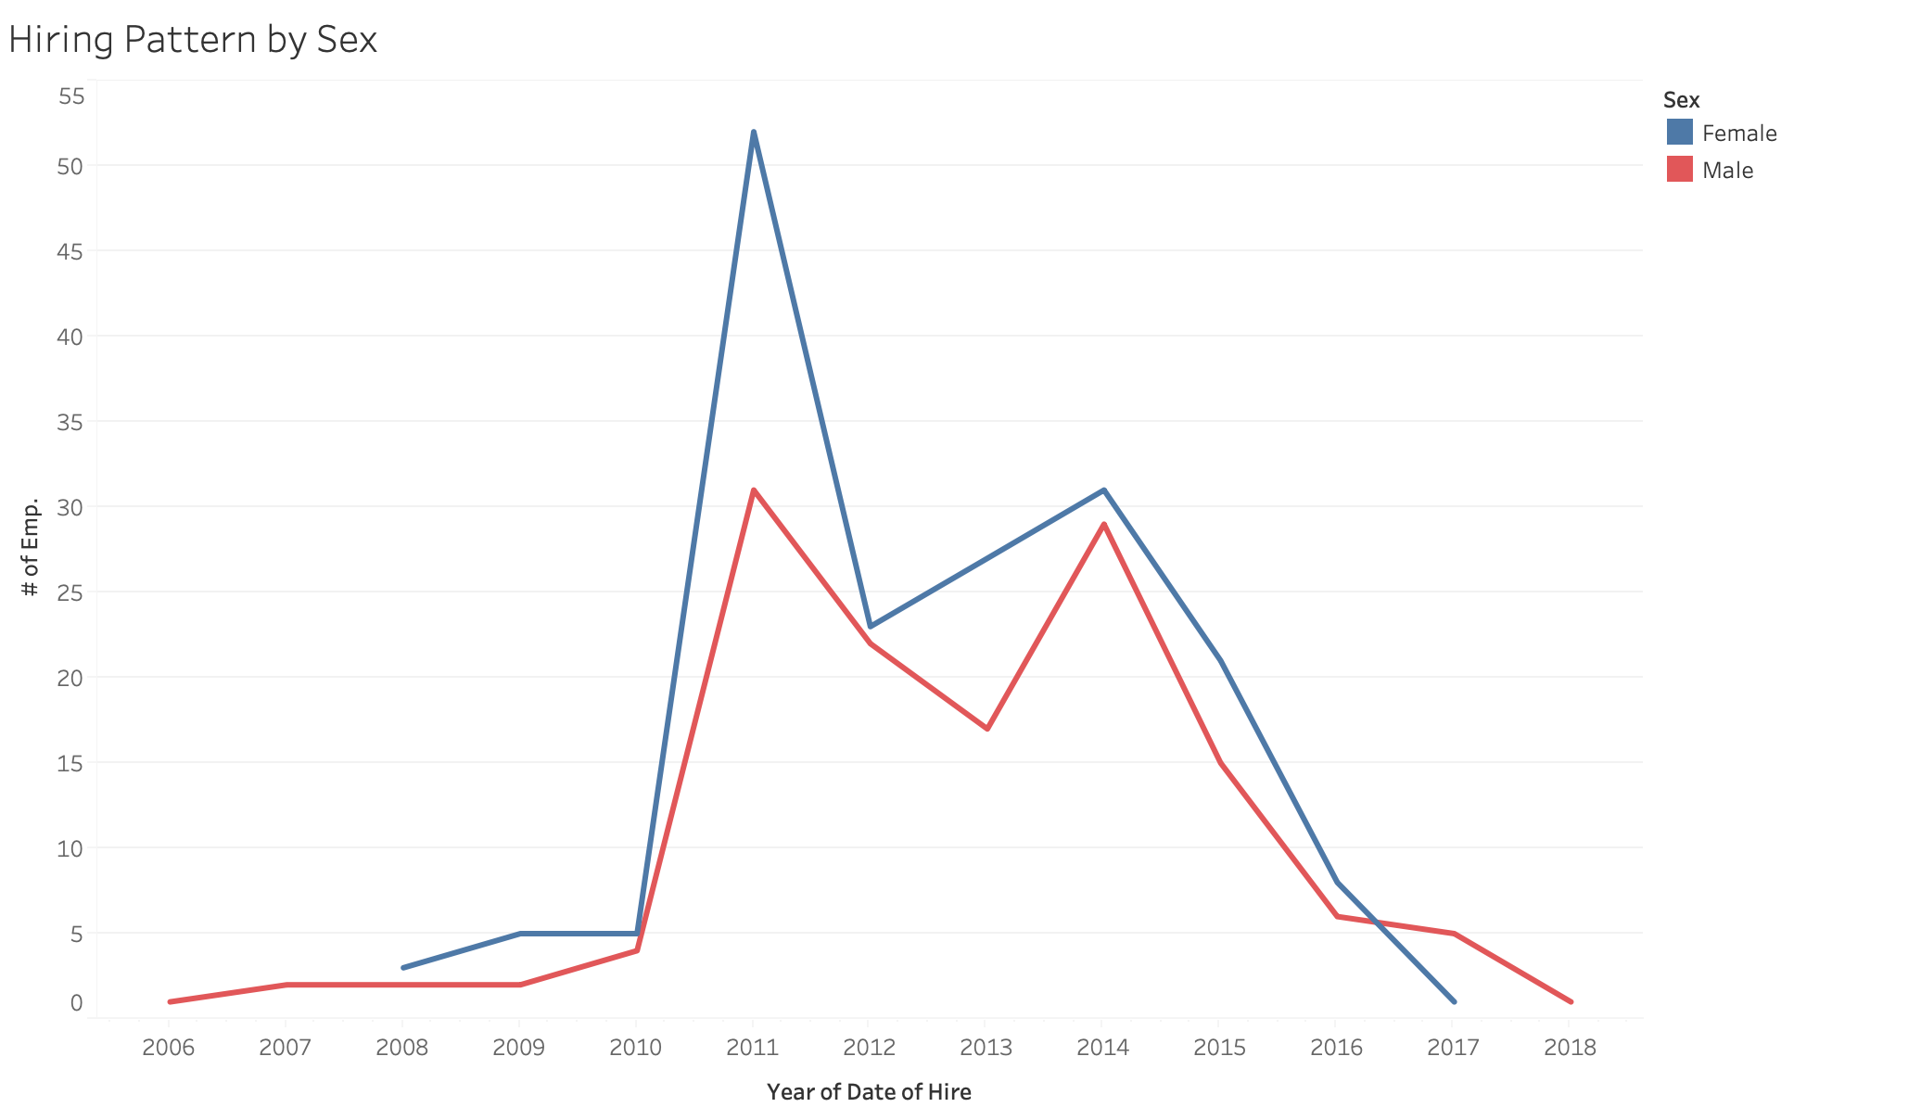

Slide 14
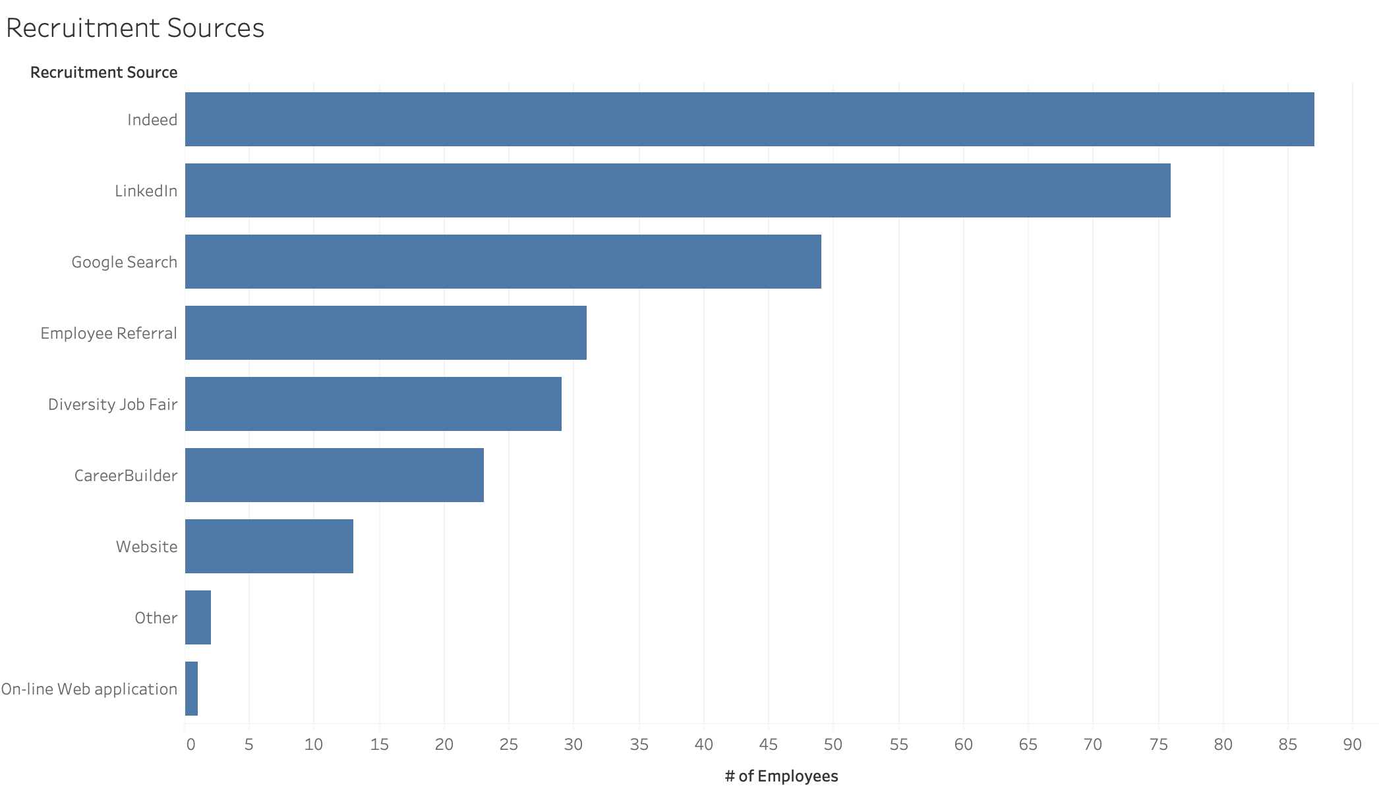

Slide 15
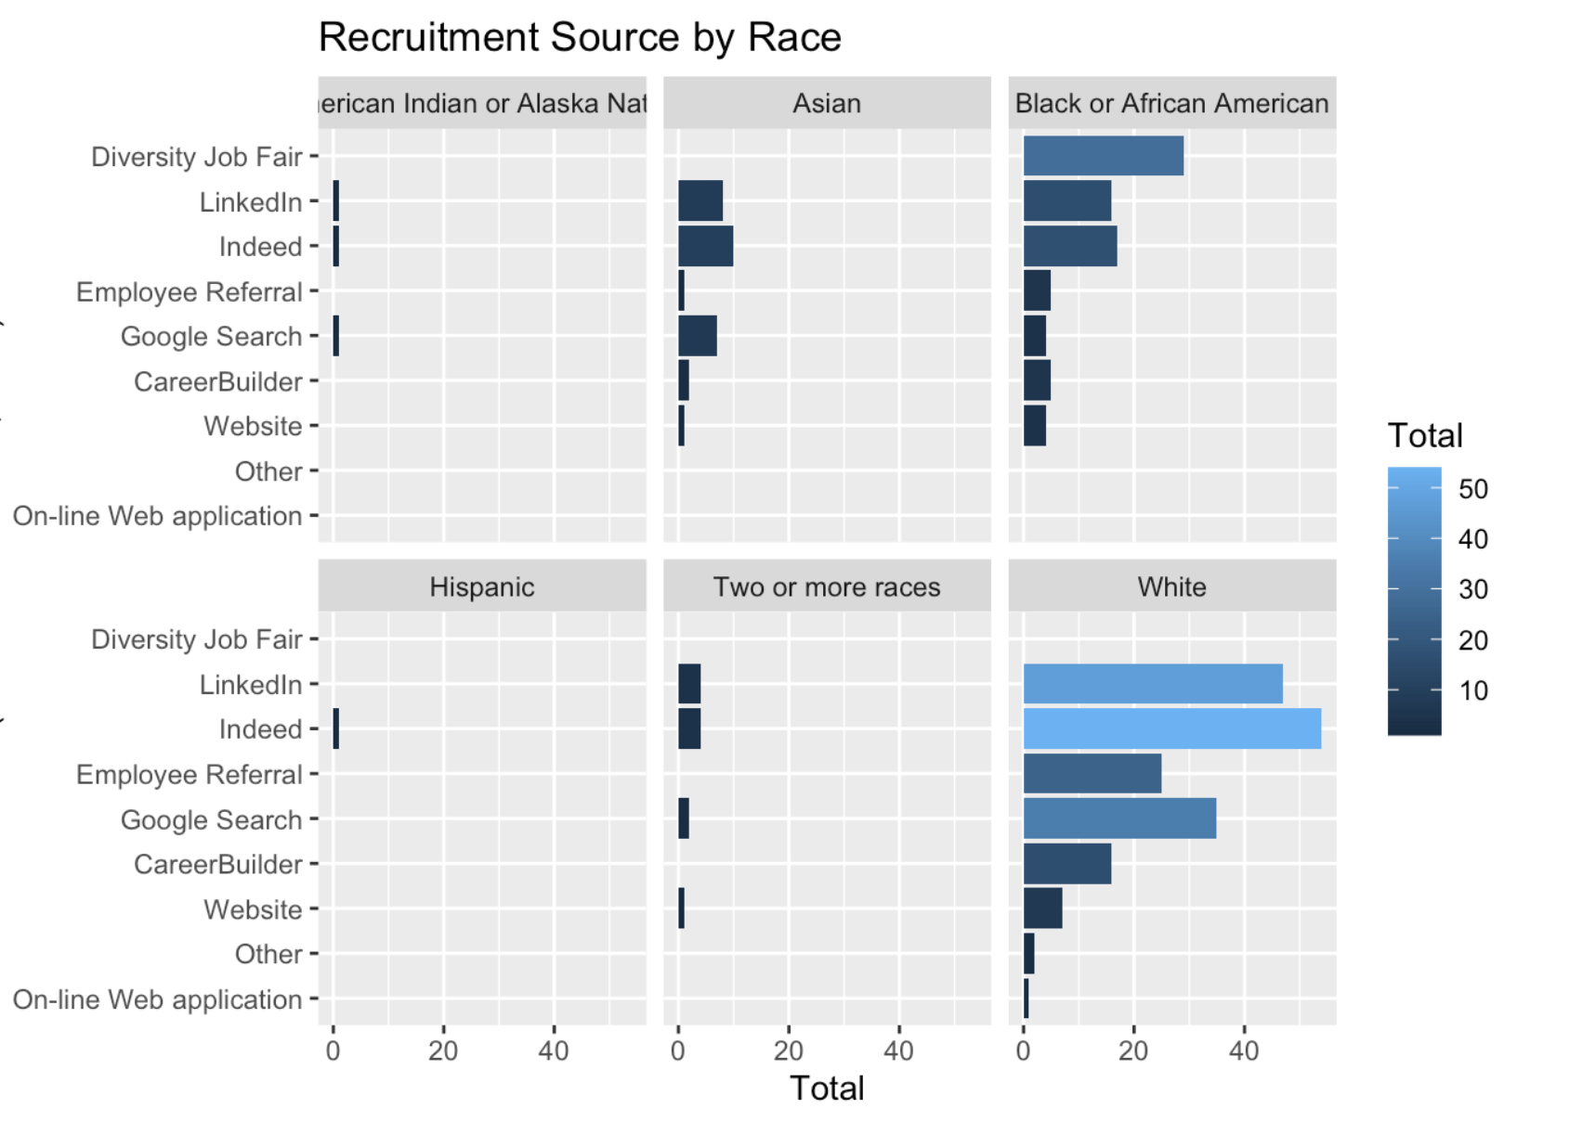

Slide 16
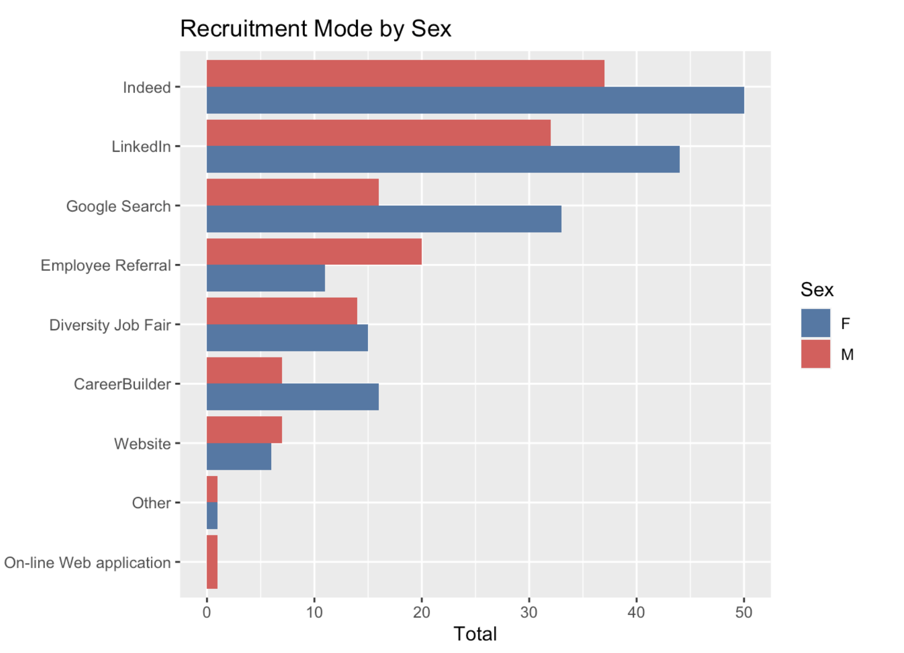

Slide 17
The Big Question: How to Keep Employees?
Probable factors: NumYearsWorked, Age, EmpSatisfaction, EngagementSurvey, Absences
Linear Regression Model: Relatively Inconclusive
lm(formula = Termd ~ NumYearsWorked + EmpSatisfaction + Age,
data = data)
Residuals:
Min 1Q Median 3Q Max
-0.7155 -0.2706 -0.0364 0.2249 1.0754
Coefficients:
Estimate Std. Error t value Pr(>|t|)
(Intercept) 0.864771 0.141598 6.107 3.06e-09 ***
NumYearsWorked -0.119047 0.007661 -15.540 < 2e-16 ***
EmpSatisfaction -0.010103 0.022136 -0.456 0.6484
Age 0.004039 0.002270 1.779 0.0762

Slide 18
Issues and Ways to Analyze Further
Not enough data
What about all the many reasons why someone may quit? (Manager, Race, Sex, Performance, Salary)- Too many reasons to factor in.
Is 311 employees enough to predict likelihood?
Only 16 were terminated for a cause.
May require complicated machine learning models
Decision tree may provide what factors are truly more important
Advanced regression may provide more insight

Slide 19
Questions?

